Slide 1
BOOK DATASET
DATA ANANLYSIS PROJECT
TEJAS.V.KANGOD
1RN20IS172
G.TARUN KUMAR
1RN20IS054

Slide 2
DATA SET
The data set contains information to describe all the entities that are associated with a book store . This data helps firms to analyse the quality of books they have and make informed decisions while placing order for new books by making use of existing data
PROBLEM STATEMENT
Determine the attributes of a particular book which will make it a success amongs the public.
Find useful data which would help firms and libraries in decision making
Determine relation on how the rating of book is affected by parameters

Slide 3
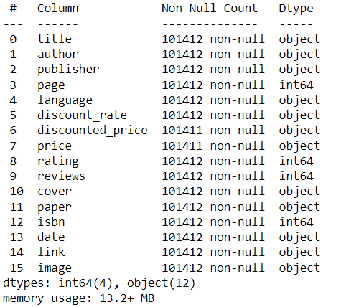
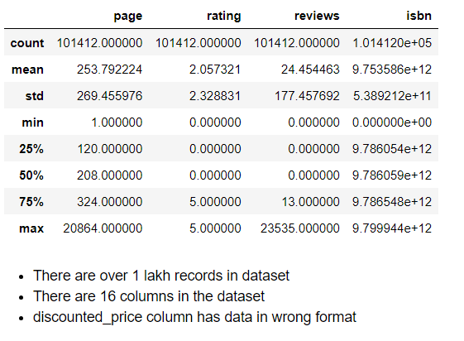
DETAIL INFO OF DATA SET

Slide 4
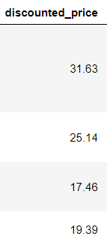
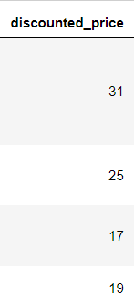
PRE-PROCESSING
CONVERTING DISCOUNTED_PRICE VALUES
BEFORE
AFTER
This column has mixed data types of float and str.
Some data is of form 30.00.01 which makes no sense
So it is necessary to convert them to integer form i.e 30.00.01 represented as 30

Slide 5
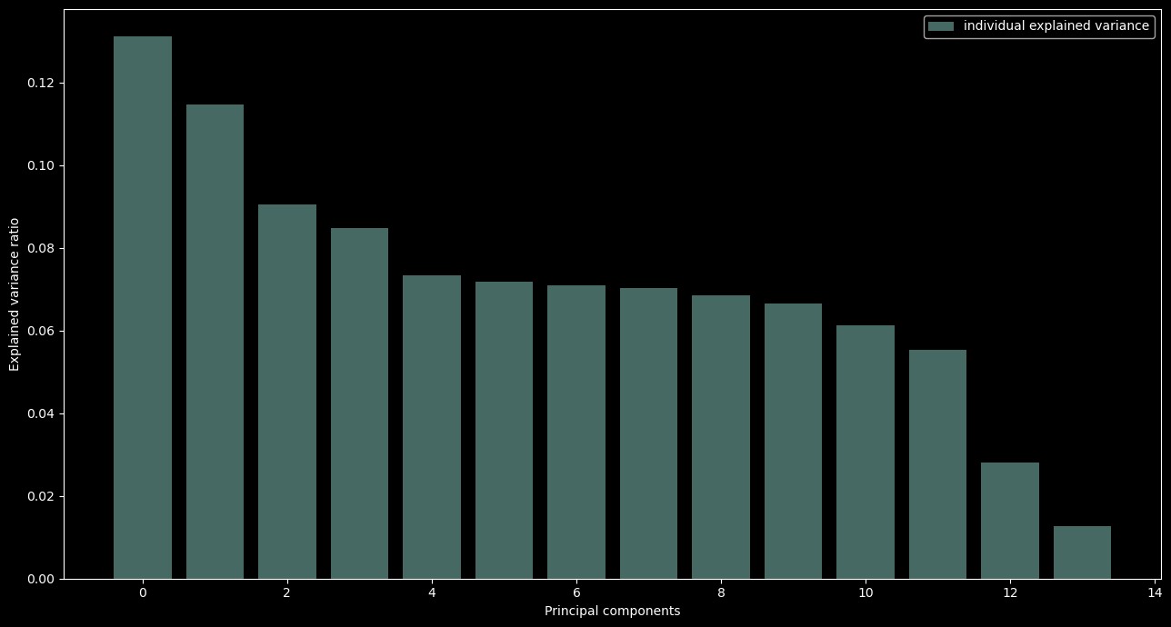
Principal Component Analysis (PCA)
This algorithm is used to determine the dependency of a column with the rest of columns in dataset
We can see that title, link, image columns have covariance outlying the remaining columns
So it OS benificial to keep these columns out while trying to analyse data to reach best possible conclusion with least errors

Slide 6
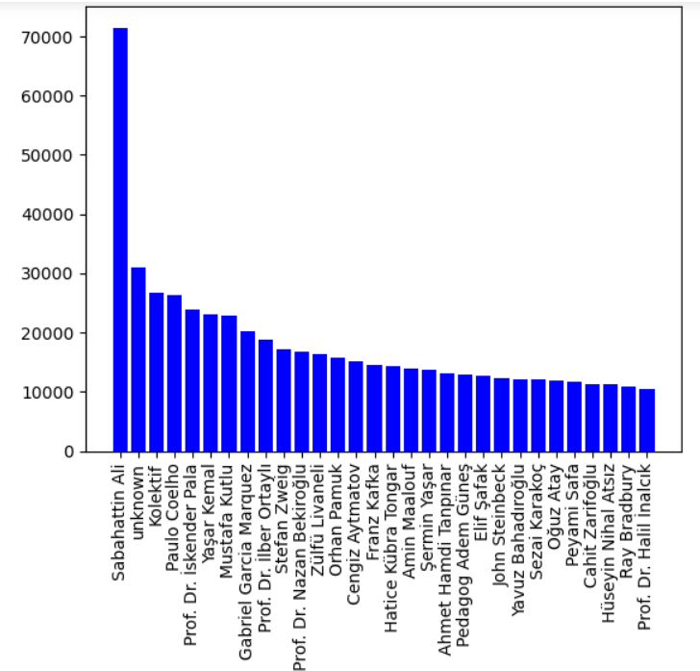
EXPLORATORY DATA ANALYSIS
AUTHOR VS REVIEWS
The dataset is filtered to represent top 30 authors along with their reviews
Subhatin ali is the best author with 71524 reviews overall
His book kurk mantolu madonna is his best book 23535 reviews

Slide 7
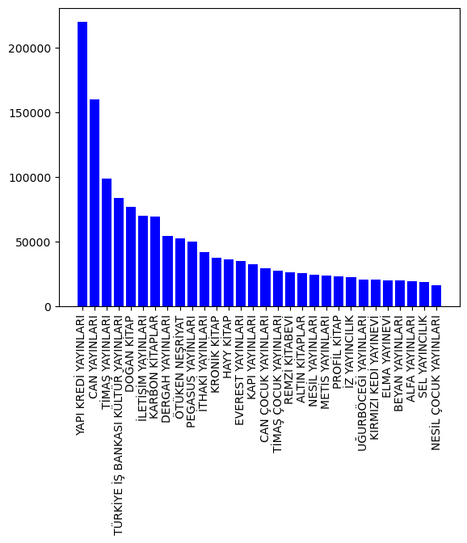
PUBLISHERS VS REVIEW
The dataset is filtered yo represent the top 30 publishers along with their reviews
Yapi kredl yayinlari is the best publisher who have accumulated 219896 reviews overall
Kurk mantolu madonna is their best book published with 23535 reviews

Slide 8
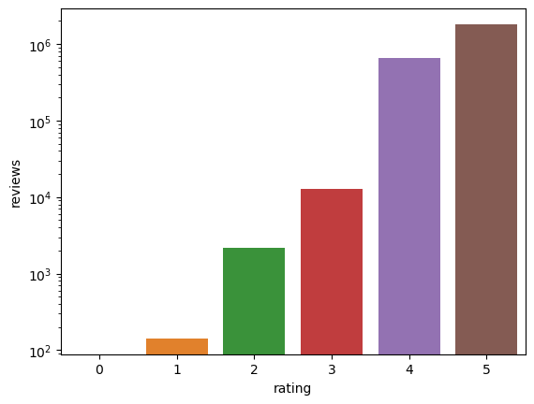
RATING VS REVIEW
This graph was plotted to show that a high rated book does well in market than low rated book
Books rated 5 have accumulated 1812133 reviews whereas books rated 0 have 0 reviews . So doubtful of any sales

Slide 9
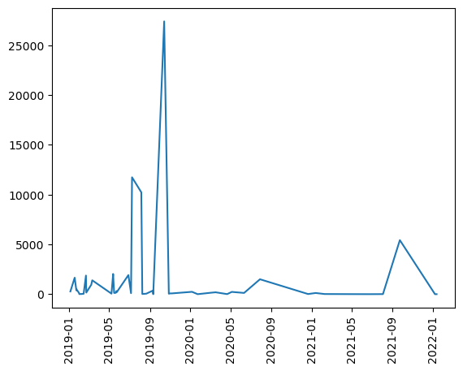
Growths of an author
This graph represents the career growth of best author dataset Subahattin Ali
Majority of his success has been within a span of few months only
His books arent doing well recently or he hasn't written any books

Slide 10
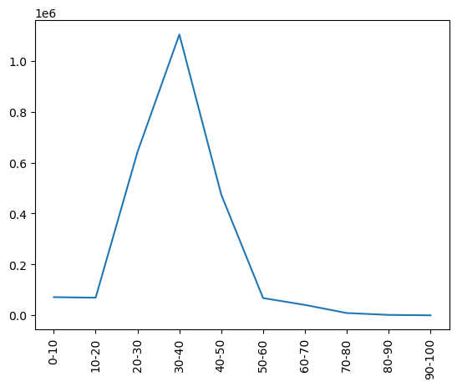
DISCOUNT RATE VS REVIEWS
This graph is used to analyse what is the best discount range to be give to attract maximum number of customers
30-40% discount is ideal to have maximum possible customer base

Slide 11
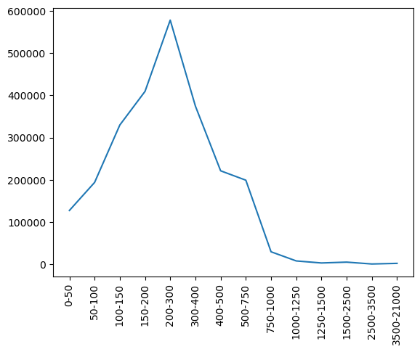
PAGE VS REVIEWS
This graph is used to represent the optimum size of content to be in a single book
Maximum demand is for books with 150-300 pages
So it os benificial to split the story on multiple books if it exceeds ( make sequels)

Slide 12
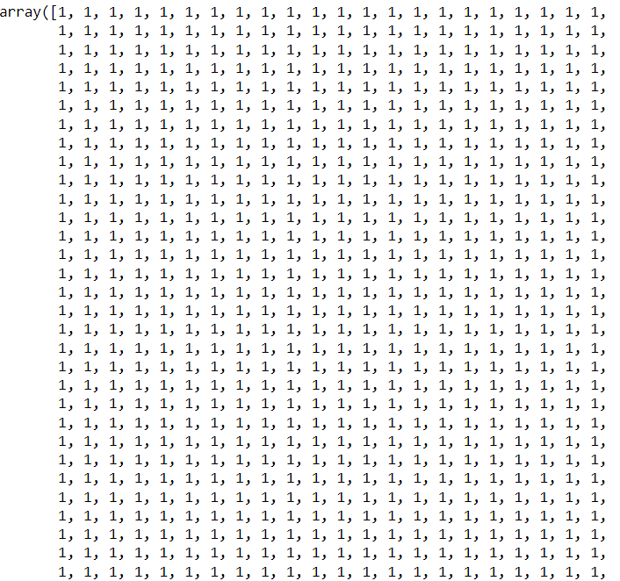
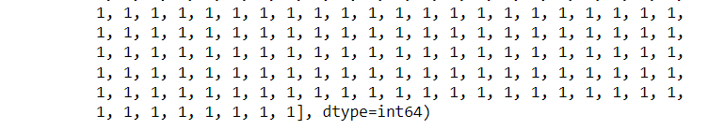
MODEL BUILDING
LOGISTIC REGRESSION
“Rating ” column has values from 0-5 so we converted such that
1 if rating is 5
0 is rating is 0-4
So by using logical regression records are classified to whether rating is 5 or anything but 5

Slide 13
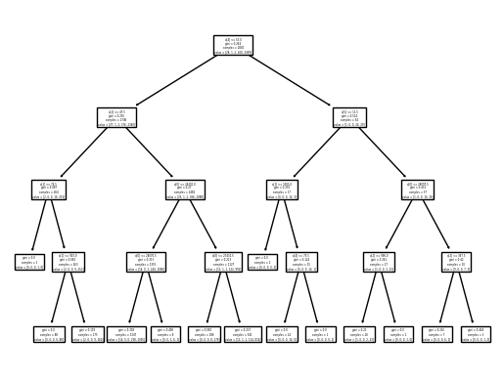
DECISION TREEE
We are trying to classify the records with labels of "rating“
Dataset is sampled to 4000 records to ensure overfitting doesn't occur and less misclassifications occur

Slide 14
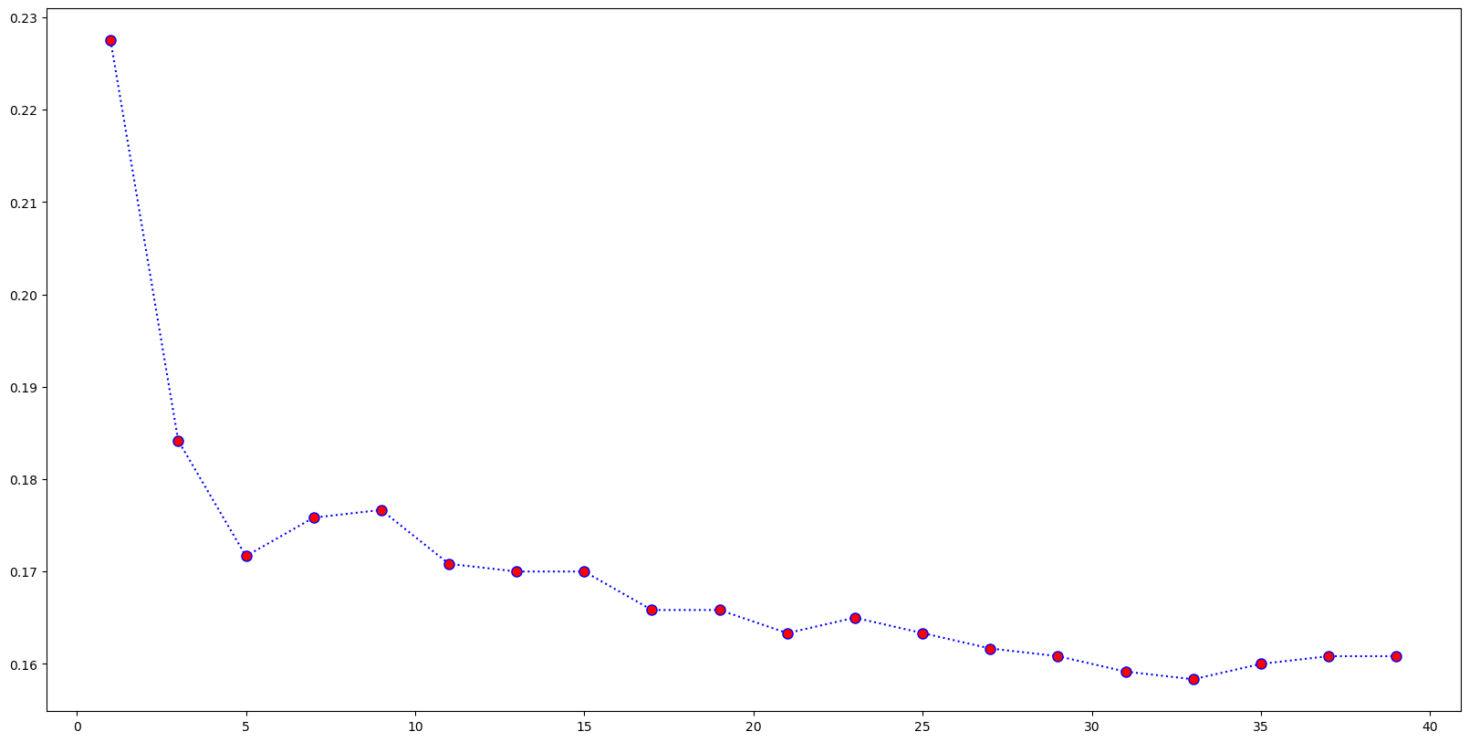
KNN CLASSIFIER
From grid search cv k= 31 is the optimum value
The records are classified into clusters of maximum size = 31 records
Accuracy of 0.85 shows that “rating ” label can be assigned to the records with less chance of classification

Slide 15

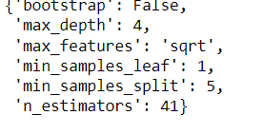
GRID SEARCH CV
KNN OUTPUT
DECISION TREE OUTPUT
This shows that the optimum size of a particular group is 31(k=31)
This shows the depth and minimum records to be there in a leaf node and for a node to be split

Slide 16
THANK YOU

